Slide 1

Analyzing Media Bias
Reema Domadia and Srijon Mukhopadhyay

Slide 2
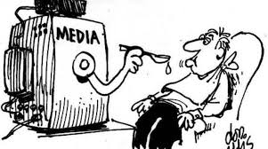
Agenda
Introduction
Literature Review
Methodology
Results & Analysis
Conclusion
References

Slide 3

Problem Statement
The echo chambers created by the biases among media outlets may, over time, cause their user base to lose touch with other viewpoints. This leads to clashes among opposing groups (i.e. conservatives and liberals) without any scope of resolution and is a threat to the unity of the people.
It is thus critical to understand the political leanings of a media outlet to have a greater clarity over the nature of information being received.
Notes:
The echo chambers or bubbles created by the biases among media outlets may, over time, cause their user base to lose touch with other viewpoints. This leads to clashes among opposing groups ( such as conservatives and liberals ) without any scope of resolution and is a threat to the unity of the people. It is thus necessary to be able to gauge whether a certain media outlets harbors any political leaning so as to have greater clarity over the nature of information being received.

Slide 4
Project Scope
To identify information biases in major news sources to provide factual and bi-partisan news

Slide 5
Literature Review
Gottfried et.al, 2014: finds that left and right information streams are distinct from those of individuals with more mixed political views
Iyyer et al., 2014: Recursive Neural Networks and Bag of Words model detect ideological biases in text
Mamidi et al., 2019: detect political bias within news headlines
Mamidi et al., 2020: contextualized word embeddings to detect bias with an F1 score of 0.70 (baseline score to emulate or improve)
Merkley, Eric, 2019: Trust in mainstream news media is on the decline
Misra et Basak, 2017: LSTM models process underlying text meaning better than the traditional RNN networks
Saenger, 2019: Media Bias Detection using Deep Learning Libraries in Python

Slide 6
Methodology
Text-Preprocessing
Models
Evaluation
Tokenization
Removed stop words and punctuations
Lower cases and stemmed text
Word Embeddings
Layer (type) | Shape
Embedding | 24 x 300
Dropout Layer (0.3) | 24 x 300
Bidirectional | 24 x 256
LSTM layer | 128
Dense Layer | 2
Binary Classification Evaluation:
F1 score: weighted avg. of the precision and recall scores
AUC curve: model’s ability to differentiate between the two classes: ‘conservative’ and ‘liberal’
load Text vectors to a pre-trained Wiki News Corpus
LSTM Architecture
Train bidirectional LSTM model with 20% of training data as the validation set
Notes:
Word Embeddings:
Vector representations or spatially represented words
Fast Text is a Facebook library for learning word representations and is an extension of the popular word2vec model for word embeddings.
For our project we used pretrained vectors of a million words from the WikiNews corpus (till 2017)
We used the word2vec model to fit these vectors

Slide 7
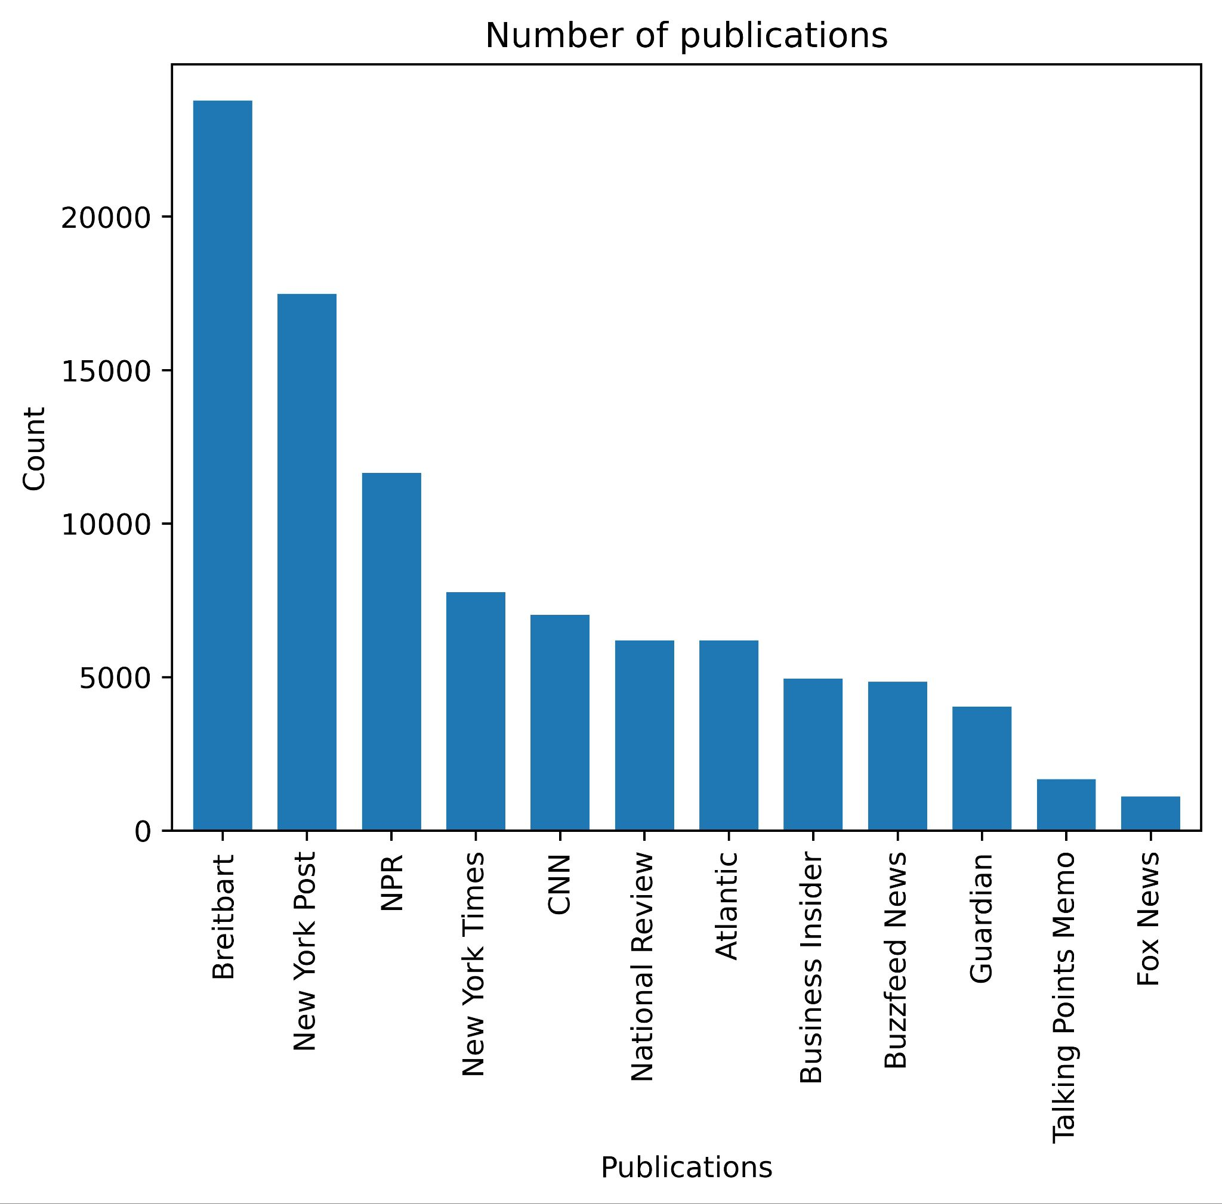
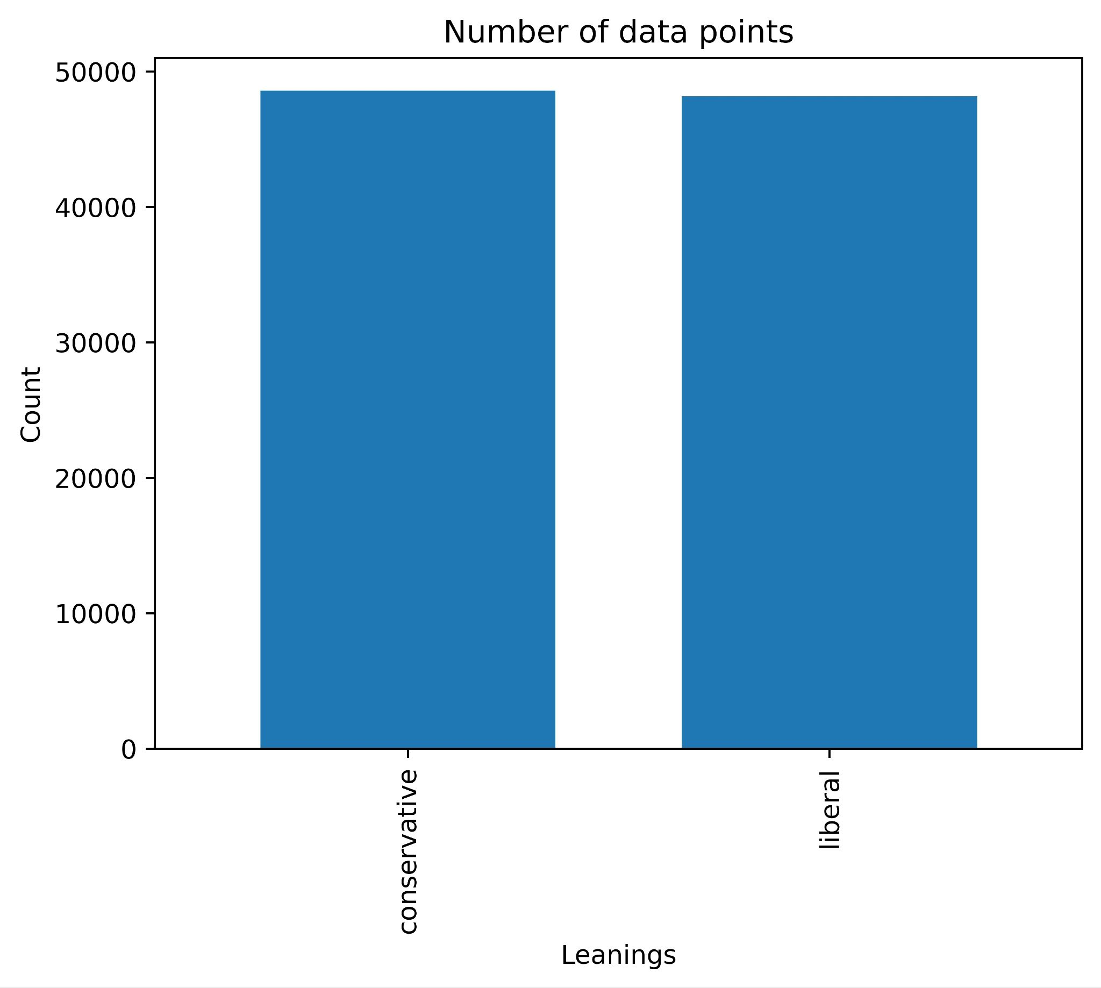
Publication Dataset
Originally created by Andrew Thompson, ComponentOne
143,000 articles from 15 publications
Date Range: 2014-2017
Variables include Column Name, ID, Title, Publication, Leaning
143,000 Articles
96,749 Articles
Notes:
Our final dataset had 96749 data points after removing the publications and NA values
Allsides and mediabiasfactcheck to assign ‘liberal’ and ‘conservative’ labels
Description: 2.7 million news articles and essays from 27 American publications. Includes date, title, publication, article text, publication name, year, month, and URL (for some). Articles mostly span from 2013 to early 2020.
Date added: 4/3/2020
Created by: Andrew Thompson
Components is a publication and research group that assembles, investigates, and editorializes large datasets. Our members come from a variety of backgrounds and are located around the United States in Philadelphia, San Francisco, New York City, Charlottesville, and Boston.

Slide 8
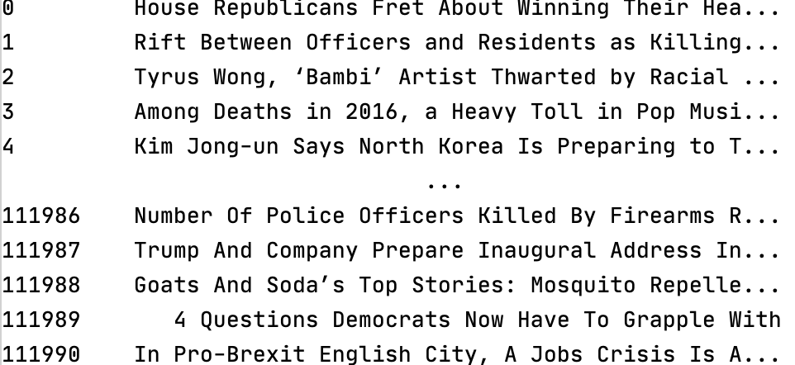
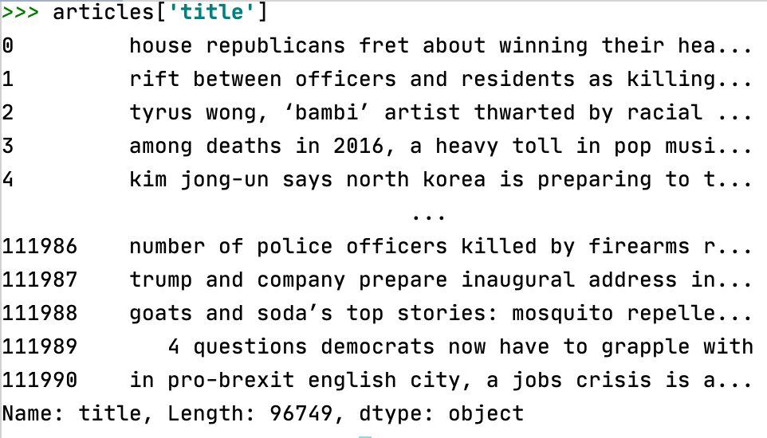
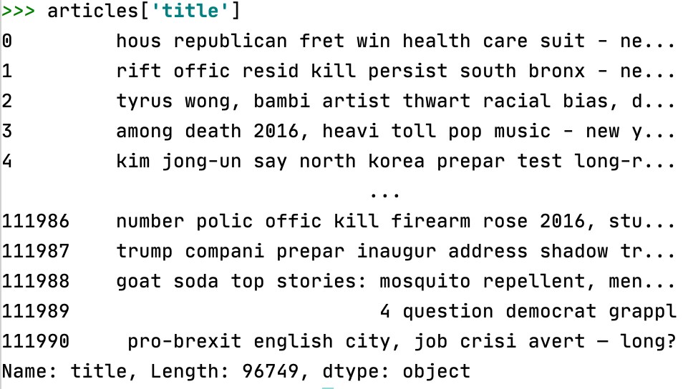
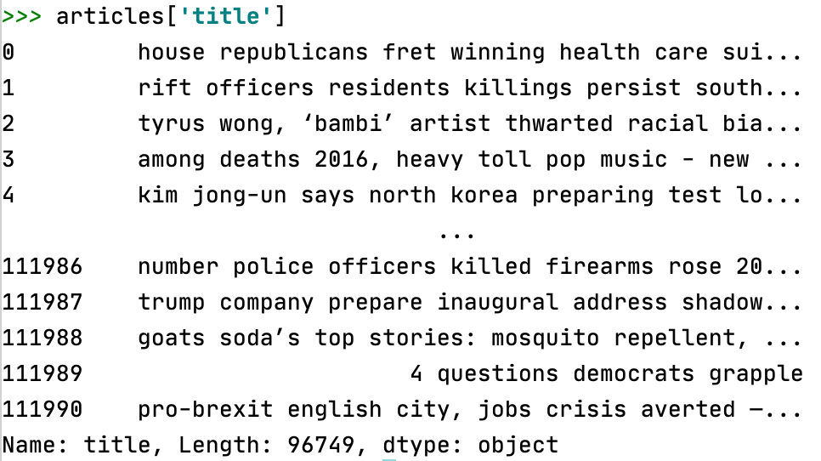
Pre-Processing
Lower Case
Remove Stopwords
Stemming
Notes:
Our final dataset had 96749 data points after removing the publications and NA values
Allsides and mediabiasfactcheck to assign ‘liberal’ and ‘conservative’ labels
Description: 2.7 million news articles and essays from 27 American publications. Includes date, title, publication, article text, publication name, year, month, and URL (for some). Articles mostly span from 2013 to early 2020.
Date added: 4/3/2020
Created by: Andrew Thompson
Components is a publication and research group that assembles, investigates, and editorializes large datasets. Our members come from a variety of backgrounds and are located around the United States in Philadelphia, San Francisco, New York City, Charlottesville, and Boston.

Slide 9
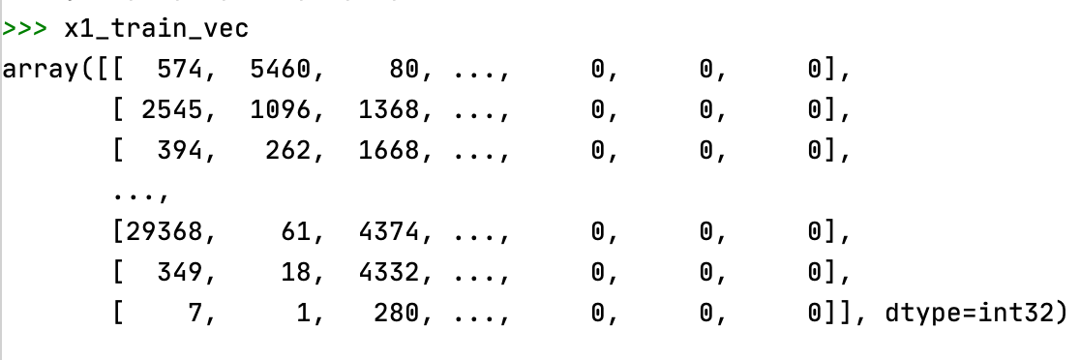
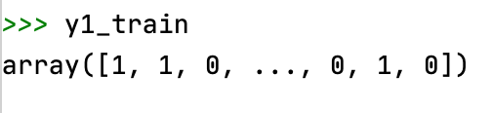
Feature Extraction
Arrays fit on keras tokenizer and converted to sequences
Split into training and test sets
Headlines converted to arrays
Dataset
Train & Test
Training and test array of headlines
Sequences
Leanings converted to labels and encoded
Sequences padded to vector form
Notes:
Our final dataset had 96749 data points after removing the publications and NA values
Allsides and mediabiasfactcheck to assign ‘liberal’ and ‘conservative’ labels
Description: 2.7 million news articles and essays from 27 American publications. Includes date, title, publication, article text, publication name, year, month, and URL (for some). Articles mostly span from 2013 to early 2020.
Date added: 4/3/2020
Created by: Andrew Thompson
Components is a publication and research group that assembles, investigates, and editorializes large datasets. Our members come from a variety of backgrounds and are located around the United States in Philadelphia, San Francisco, New York City, Charlottesville, and Boston.

Slide 10
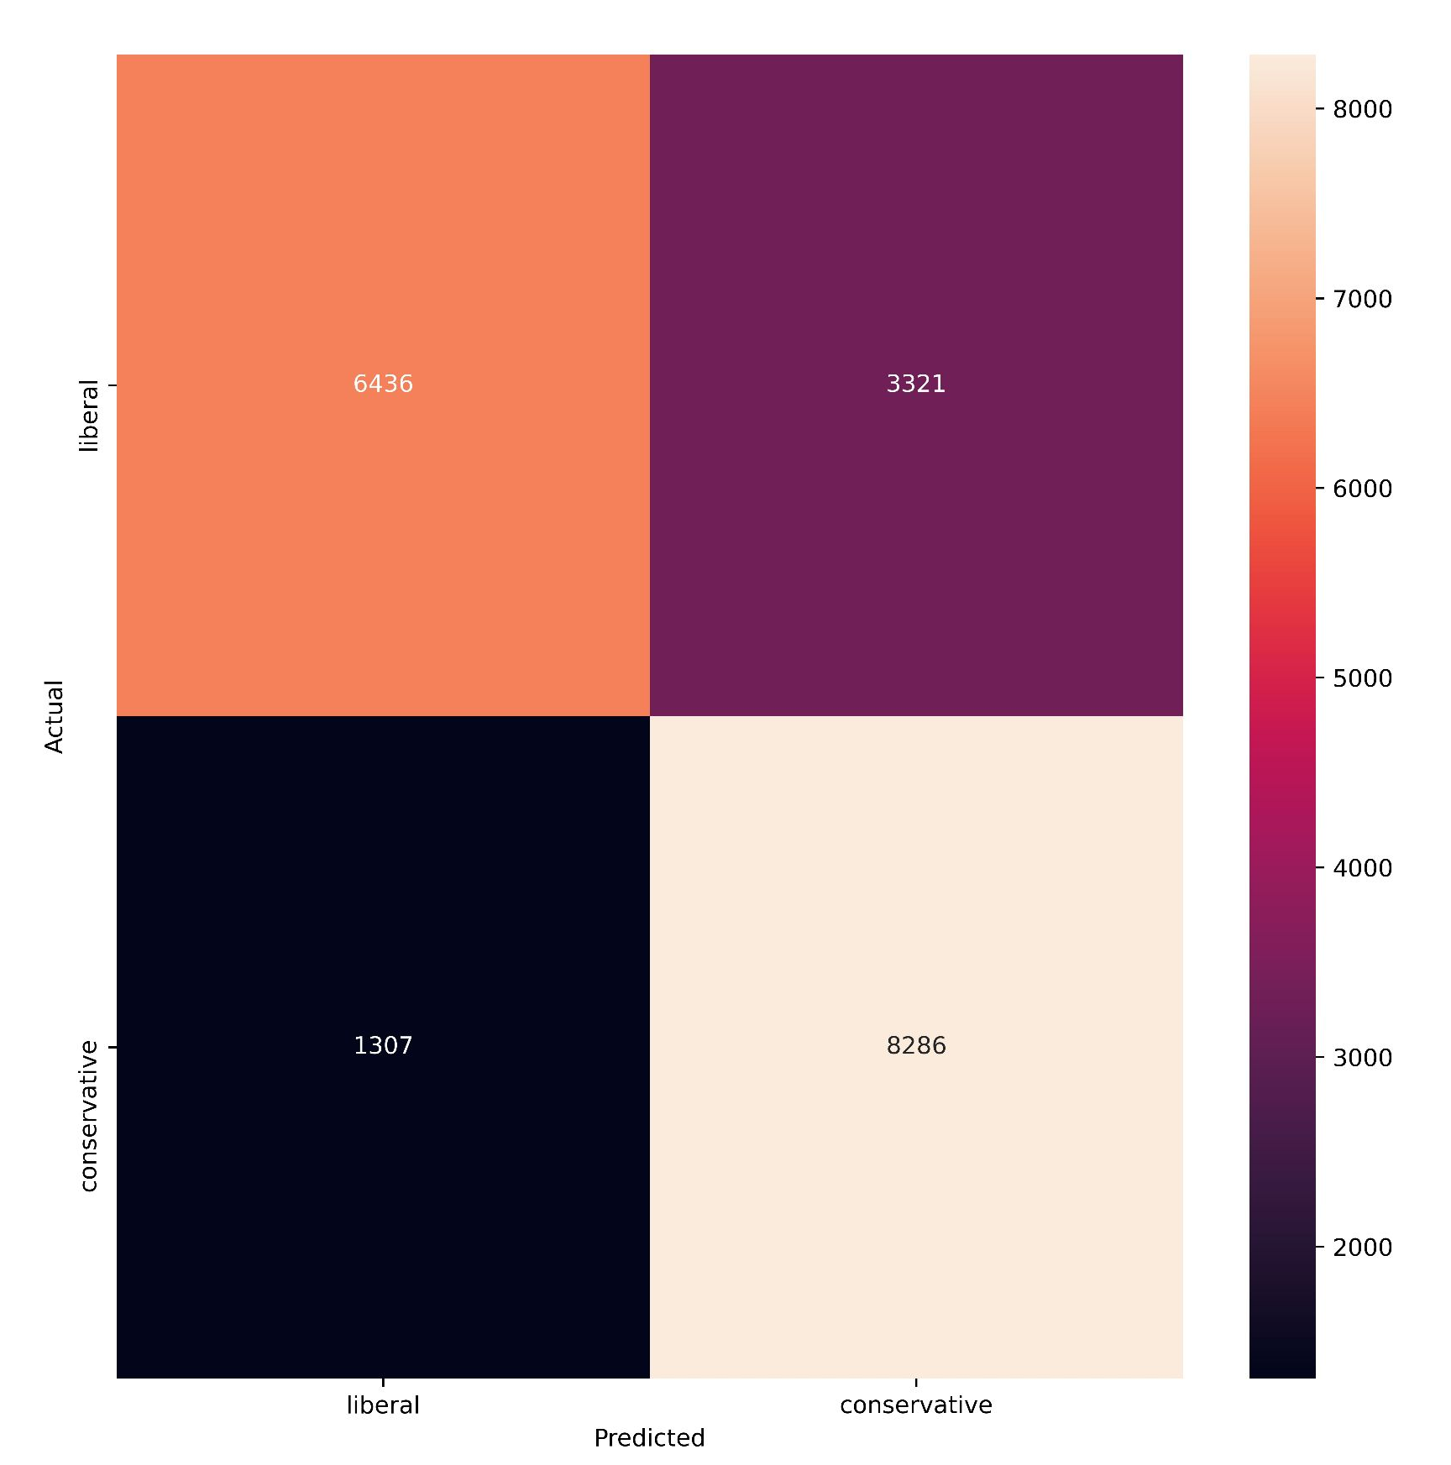
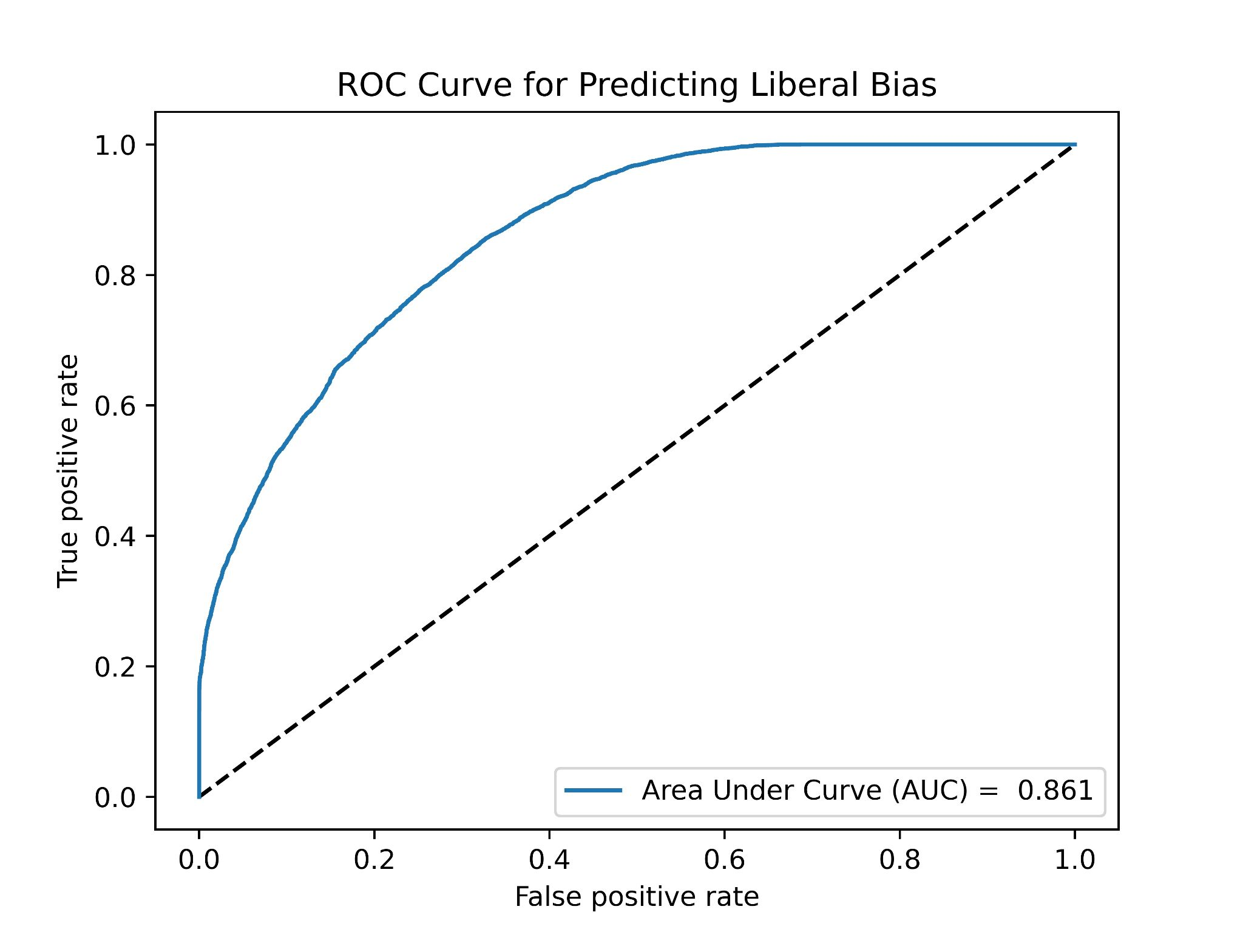
Model Evaluation
Label | Precision | Recall | F1 Score
liberal | 0.83 | 0.66 | 0.74
conservative | 0.71 | 0.86 | 0.71
Notes:
Text-Preprocessing: Aggregated response and votes by grouping the id, title, body, and tags
Removed codes and HTML tags from body and responses
Tokenization
Removed stop words and punctuations
Model Configuration: Word2Vec Algorithm: convert text to a vector space
LSTM architecture: classification of tags
- Adam Optimizer
- Early stopping

Slide 11
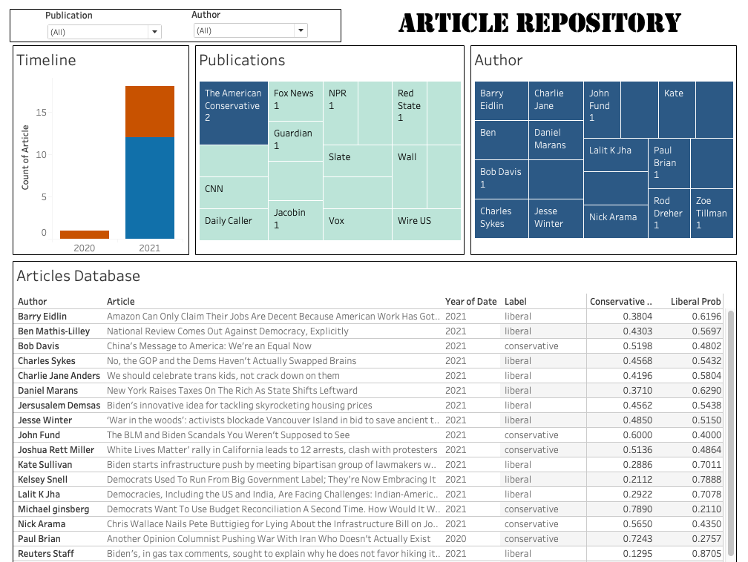
Tableau Dashboard
Variables:
Column Name
ID
Title
Publication
Leaning

Slide 12
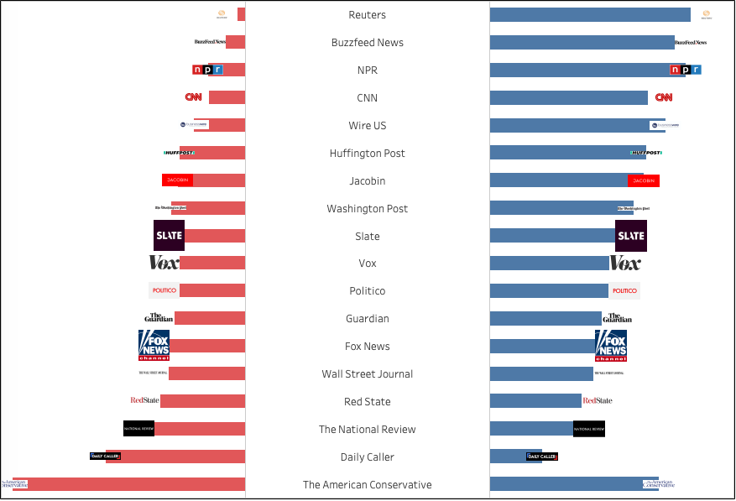
Publication Bias Breakdown
Top 5 (Conservative):
The American Conservative
Daily Caller
National Review
Red State
Wall Street Journal
Top 5 (Liberal):
Vox
Buzzfeed News
NPR
CNN
Wire US

Slide 13
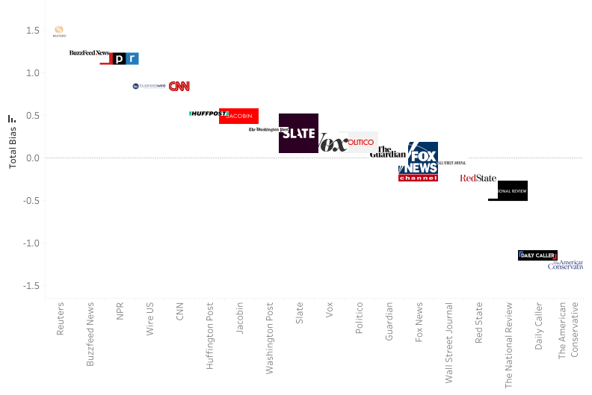
Bias Based on Publication

Slide 14
Conclusion
Limitations
Future Work
Determining additional categories, beyond binary, to prevent categorical overfitting
Newer deep contextualized representation models for semantics and linguistic variation of words
i.e. ELMo, a learned function of the deep bidirectional LSTM language model which significantly improves NLP
Top 5 Conservative Pub:
Fox News
The American Conservative
Daily Caller
National Review
Wall Street Journal
Top 5 Liberal Pub:
Slate
Vox
The Guardian
Buzzfeed News
CNN
Despite models performance beyond baseline score, the model still shows signs of overfitting
Use a larger and more diverse train dataset
Limited control over the degree of politicized headlines in the dataset
Notes:
Limitations:
Though our model is performing better than the baseline score we set, there is still some overfitting
More training examples are required to control for this
Model assigns a binary (conservative and liberal) to political bias which is not how real life data will usually behave
This affects the generalizing power of the model
Future Work:
Defining more nuanced definitions of political bias will allow for a more reliable model
Instead of using traditional pre-trained word embedding models (Glove and Word2Vec), newer representations such as deep contextualized word representations that can model semantics and linguistic variation of words
(Iyyer et al., 2018) developed ELMo, a learned function of the deep bidirectional LSTM language model which significantly improved the state of the art across various NLP tasks

Slide 15
References
M. Iyyer, P. Enns, J. Boyd Graber, P. Resnik. Political Ideology Detection Using Recursive Neural Networks. Proceedings of the 52nd Annual Meeting of the Association for Computational Linguistics, vol 1, 2014.
R.R.R Gangula, S.R Duggenpudi, R. Mamidi. Detecting Political Bias in News Articles Using Headline Attention. Proceedings of the 2019 ACL Workshop BlackboxNLP: Analyzing and Interpreting Neural Networks for NLP. 2019.
K. Pant, T. Dadu, R. Mamidi. Towards Detection of Subjective Bias using Contextualized Word Embeddings. WWW '20: Companion Proceedings of the Web Conference 2020, pp. 75-76, April 2020.
A. Misra, S. Basak. Political Bias Analysis. CS224n, pp. 8, 2017.
M. Peters, M. Neumann, M. Iyyer, M. Gardner, C. Clark, K. Lee, L. Zettlemoyer. Deep Contextualized Word Representations. NAACL 2018, 2018.

Slide 16

Questions?

